Slide 1
DTI
Viktoras Palys, M.D.
Assistant Professor of Neurosurgery
University of Arkansas for Medical Sciences
June 3, 2019

Slide 2
Disclosure
In compliance with the Accreditation Council for Continuing Medical Education’s (ACCME) Standards for Commercial Support of CME, UAMS CME discloses all current relationships which program faculty report having with companies whose products and/or services they may discuss during their presentation. In addition, all presenters must disclose to the audience when any material they present recommends an off-label or unapproved use of a drug, procedure or piece of equipment.
Viktoras Palys discloses having no relevant financial relationships to report

Slide 3
Learning objectives
Theory of DTI
Practical examples using Medtronic StealthViz.

Slide 4
DTI workflow (Pipeline)
1. DTI data acquisition
2. Tensor Preparation
3. Tractography
1 is done with regular MRI scanner, directed by radiologist (neurosurgeon can only suggest some parameters).
2 and 3 are post-processing steps - can be done either by radiologist or neurosurgeon – whoever has the software.

Slide 5
1. DTI data acquisition

Slide 6
1. DTI data acquisition
MR scanning parameters:
Slice thickness – thinner the better (standard – 2 mm).
Slices have to be contiguous (no gaps!)
Directions (gradients)
only 6 directions are required to compute tractography.
standard – 30 or 32; common – 64.
more directions would provide more directional fidelity at the cost of some planar fidelity (e.g. more opportunity for tracks to “disappear” within a slice).

Slide 7
1. DTI data acquisition
MR scanning parameters:
NEX – number of repetitions of same scan (improves signal-to-noise ratio).
varies from 1 to 3 (scan time from 4 to 12 minutes).
disadvantage - patient motion between acquisitions.
MR field strength – stronger diffusion signal but more geometrical distortion.

Slide 8
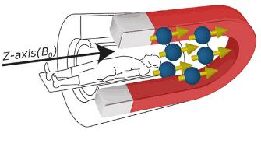
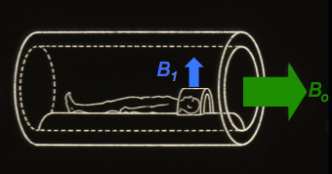
1. DTI data acquisition
Glossary:
B0 – main static (constant) magnetic field of magnet - measured in teslas (e.g. 3T scanner).
the direction of B0 is along the longitudinal (z) axis of the patient.
vs. B1 - temporary magnetic field generated by transmit coil emitted RF waves in order to perturb the magnetization in some manner (e.g. excitation pulses, inversion pulses, etc). B1 is perpendicular to B0.

Slide 9
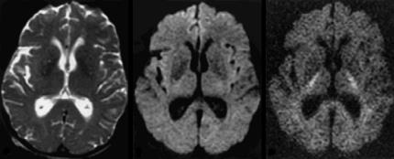
1. DTI data acquisition
Glossary:
b-value - a factor that reflects the strength and timing of the gradients used to generate diffusion-weighted images.
it is operator-selected parameter.
diffusion is the flux of particles across a surface in a period of time, so unit is s/mm².
no optimal value (chosen between 0 and 1000 s/mm²; modern scanners can do up to 4000 s/mm²).
the higher the b-value, the stronger the diffusion effects but also more noise.
DWI images using 3 different b-values (0, 1000, and 3000 s/mm²):
Notes:
From 0 to 3000 progressively more diffusion weighting (as evidenced by the brighter corticospinal tracts) but also more noise

Slide 10
2. Tensor preparation 1) Calculating Tensor 2) Generating Maps

Slide 11
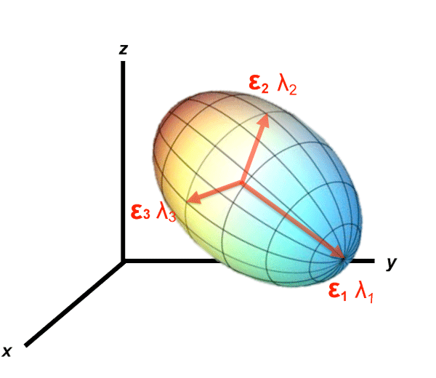
2. Tensor preparation
1) Calculating Tensor
The architecture of the axons in parallel bundles and their myelin shield facilitate the diffusion of the water molecules along their main direction.
If we apply diffusion gradients in different directions, it is possible to calculate, for each voxel, a diffusion tensor (i.e. a 3x3x3 matrix) that describes this diffusion anisotropy:

Slide 12
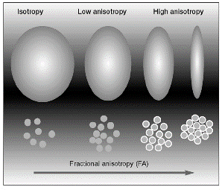
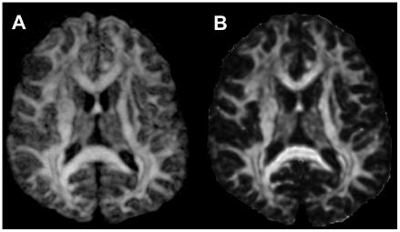
2. Tensor preparation
2) Generating Maps
Fractional Anisotropy (FA) - measures preferential directionality of diffusion at the voxel
expressed as a numerical value between 0 to 1.
high FA indicates a great degree of preferential directionality (anisotropy) such as in the highly organized WM tracts.
low FA indicates less preferential directionality such as in the gray matter and CSF where FA is 0 (isotropy).

Slide 13
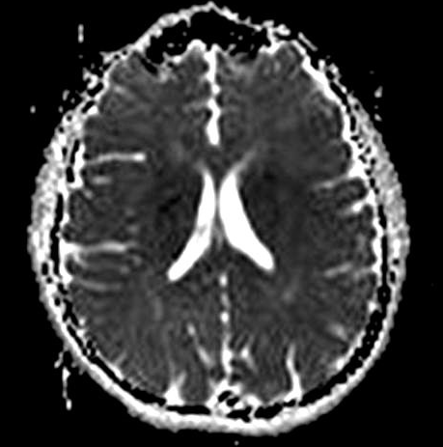
2. Tensor preparation
2) Generating Maps
Apparent Diffusion Coefficient (ADC) - voxel-by-voxel measure of the magnitude of diffusion in certain direction.

Slide 14
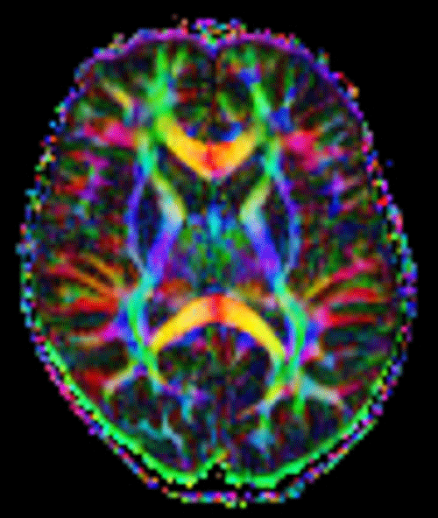
2. Tensor preparation
2) Generating Maps
Directionally Encoded Color-coded map (DEC)
colors indicate tensor orientation in anatomical space.
by convention:
blue color is used to highlight the tensors oriented (tracts traveling) in the inferior-superior direction (“blue sky is up”);
green in the anteroposterior direction (“walk forward on the green grass”);
red in the left-right direction (“red heart is on the left”).

Slide 15
3. Tractography 1) Fiber tracking 2) Visualizing the WM tract of interest

Slide 16
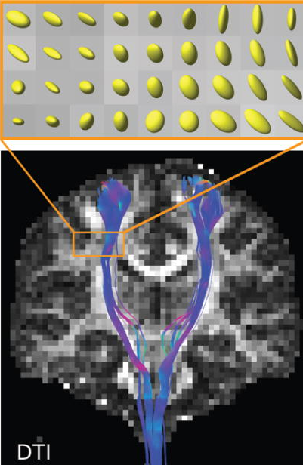
Tractography algorithms
1) Fiber tracking - this is how white matter tracts are computed using available tensors:
A. Deterministic – philosophy: one voxel is determined to contain only one fiber bundle
software commercially available.
some fiber tracts get truncated at crossing points - software leaves only one fiber bundle (the strongest) and eliminates other bundles.

Slide 17
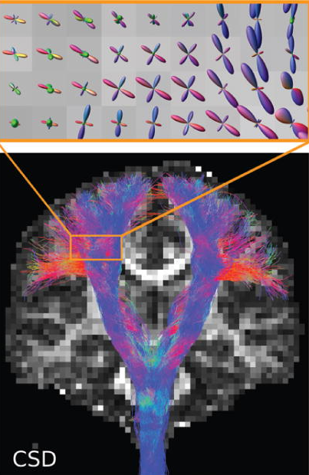
Tractography algorithms
1) Fiber tracking - this is how white matter tracts are computed using available tensors:
A. Deterministic – philosophy: one voxel is determined to contain only one fiber bundle
software commercially available.
some fiber tracts get truncated at crossing points - software leaves only one fiber bundle (the strongest) and eliminates other bundles.
B. Probabilistic – philosophy: one voxel is analyzed for probabilities of containing > 1 fiber bundle
commercially unavailable for clinical use (FDA requires validation using subcortical stimulation).
most are open source – free to download.
most advanced package – FSL (developed in Oxford) – developers offer 3-day course just to learn how to use it.
computation time is enormous.

Slide 18
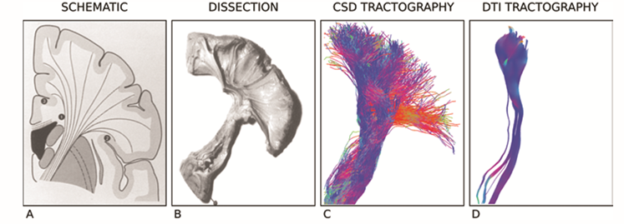
Tractography algorithms
1) Fiber tracking:
C. Constrained spherical deconvolution (CSD) - higher-order probabilistic model that uses the same data but demonstrates fiber tracts even more accurately:

Slide 19
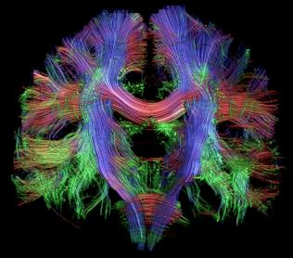
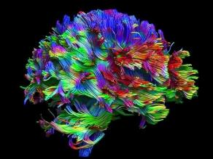
Tractography
2) Visualizing the WM tract of interest – final step:
A. Whole brain– philosophy: make all WM tracts visible and select the one you need
almost automated, probably most user-friendly method (“point-and-shoot”).
potentially difficult for anatomically distorted WM tracts.
impossible to do anatomically more precise work.

Slide 20
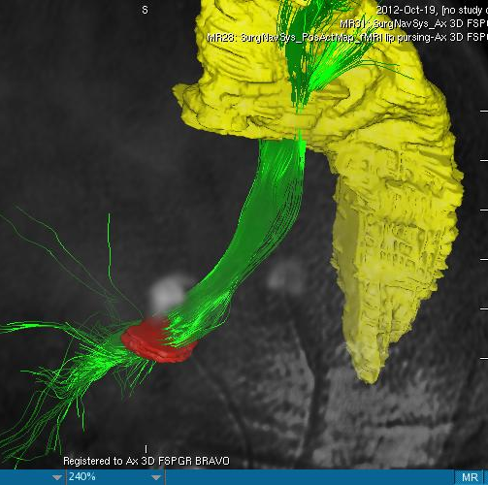
Tractography
2) Visualizing the WM tract of interest – final step:
B. Seeding ROI (region of interest) – philosophy: WM tract consists of fibers travelling between two (or more) ROIs
select seeding ROI - can be anatomical structure (e.g. motor cortex – for pyramidal tract) or fMRI activation area (e.g. speech area).
may or may not select intermediate / end ROI (e.g. cerebral peduncle – for pyramidal tract).
click “generate fibers”

Slide 21
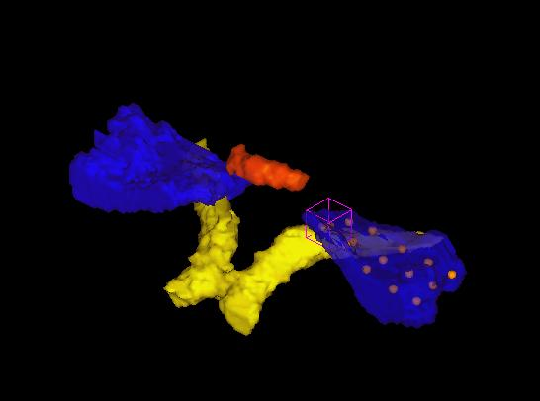
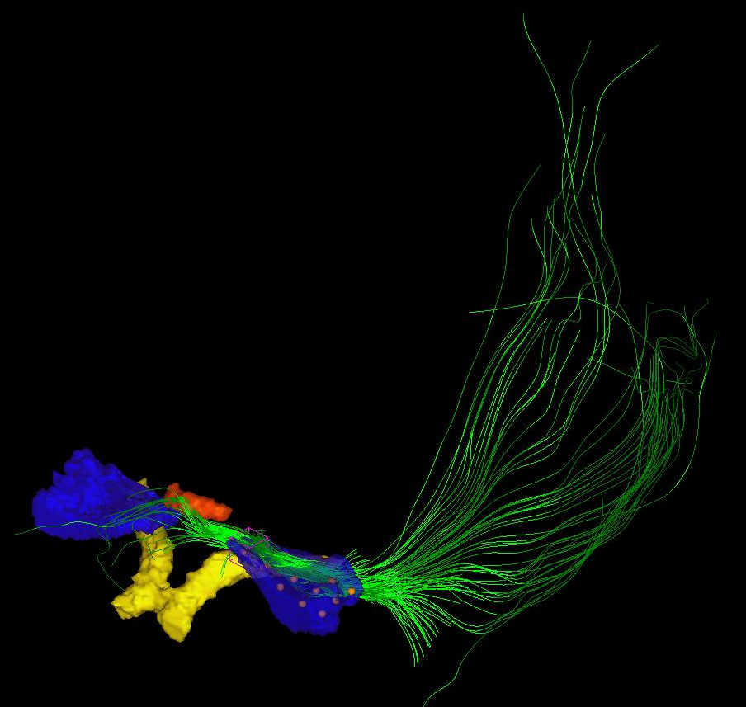
Tractography
2) Visualizing the WM tract of interest:
B. Seeding ROI (region of interest) – example of seeding from on ROI:

Slide 22
Tractography problems

Slide 23
Tractography problems
Accuracy – still rather low for DBS applications
Distortions – happen during MRI scanning.

Slide 24
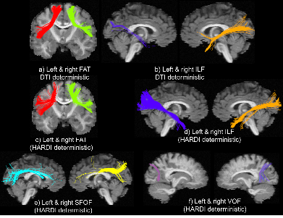
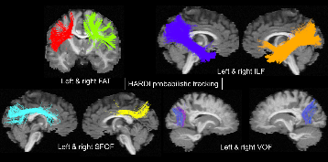
Tractography problems
False positive tracts – regardless of the tractography pipeline is used, many invalid bundles are found in the tractograms.
these invalid bundles originate from a “bottleneck“ or “high traffic” locations - where 3 or more valid bundles come together, almost in parallel.
it is alarming is how close the invalid bundles approximate true anatomical structures - connect valid cortical areas and appear to be dense and well structured:
one way to minimize occurrence – use less “relaxed” tractography parameters (decreases sensitivity, increases specificity).
Notes:
Those images were obtained from fantoms that do NOT have such tracts!

Slide 25
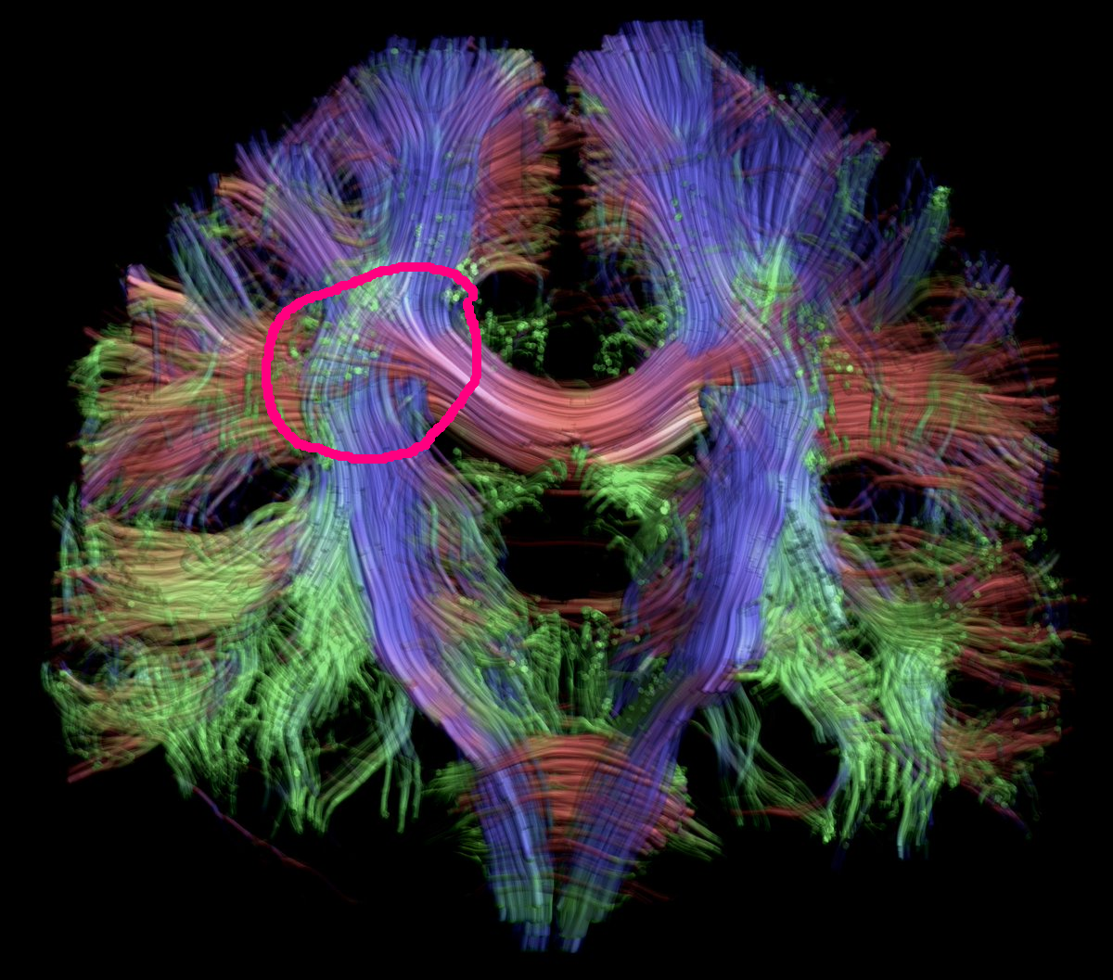
Tractography problems
False negative results – mostly where fibers get truncated at “high traffic” crossing points.
may lead neurosurgeon to potentially unsafe areas.

Slide 26
Case presentation

Slide 27
Case presentation
D.K. 65 yo male with essential tremor (ET)
tremor for > 10 years
L > R
greatly interferes with ADLs
unresponsive to medication

Slide 28
Case presentation
September 17, 2013 – right VIM DBS lead implantation.
2 week post-operative programming:
low voltage side effects for all contacts (mainly heaviness in shoulder and arm and dysarthria at more distal contacts), no appreciable improvement in tremor with any of the contacts.

Slide 29
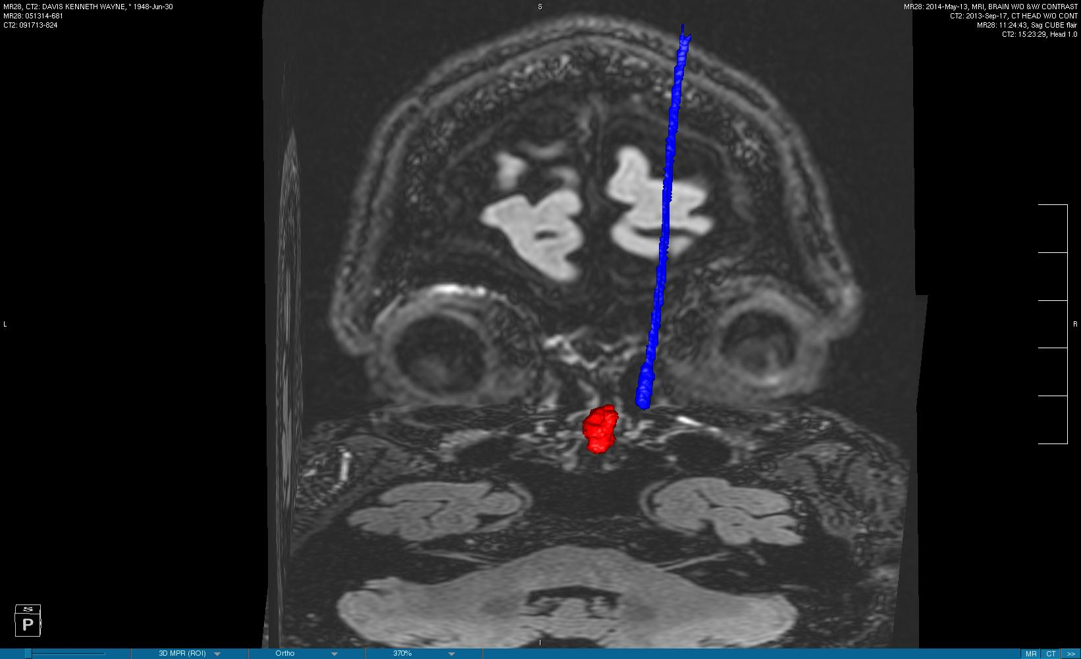
Case Presentation
Segmentation – DBS lead and ipsilateral red nucleus:

Slide 30
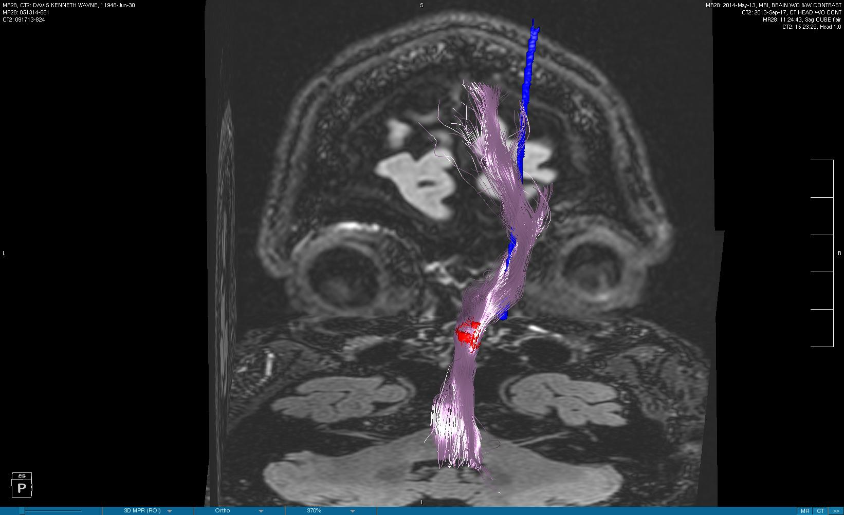
Case Presentation
Tractography – dentato-rubro-thalamic tract (seeded from red nucleus as sole ROI):

Slide 31
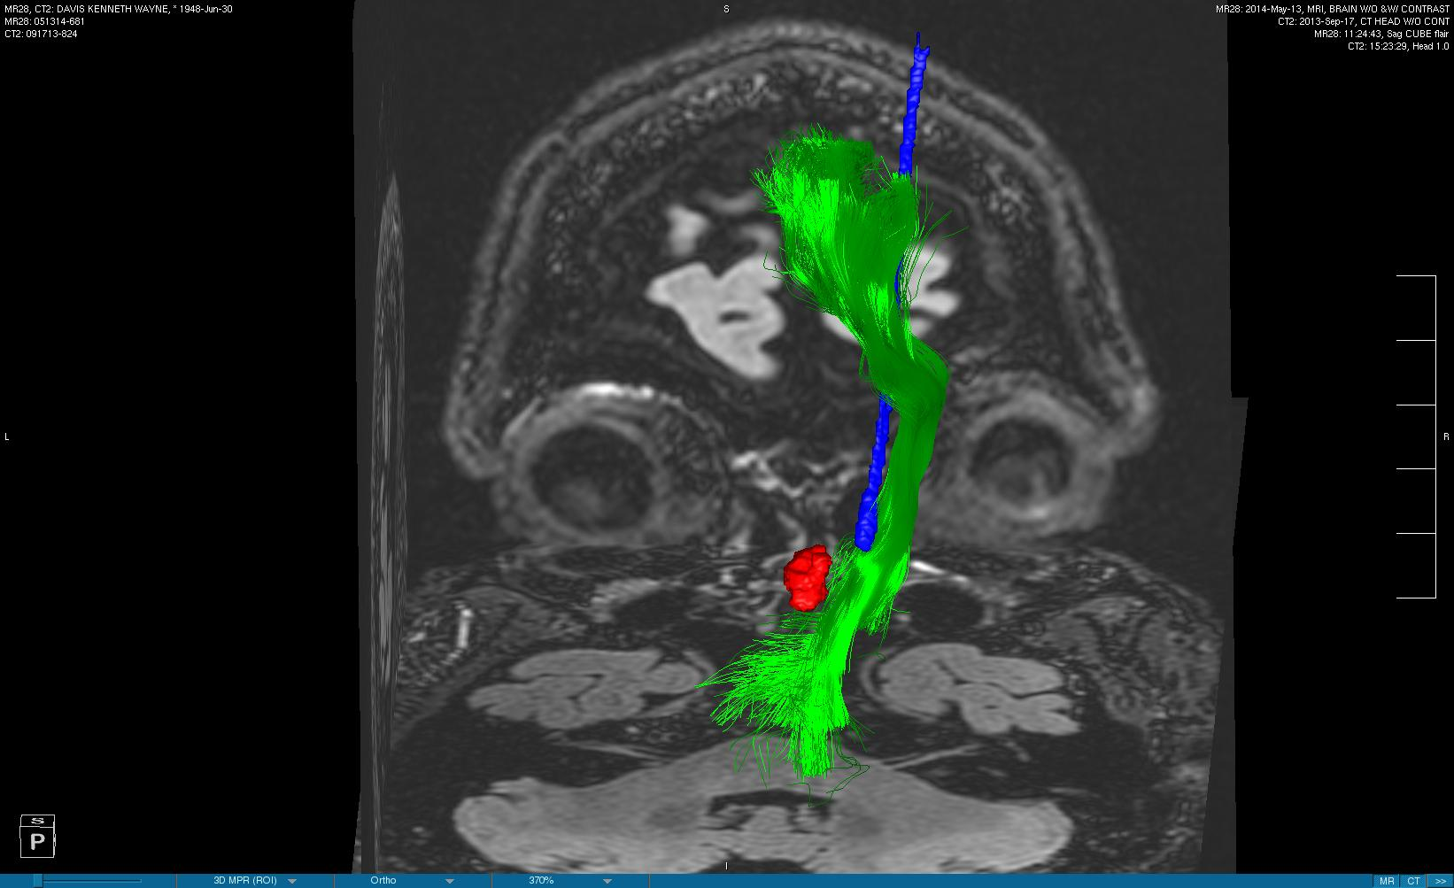
Case Presentation
Tractography – corticospinal tract (seeded from motor cortex to cerebral peduncle):

Slide 32
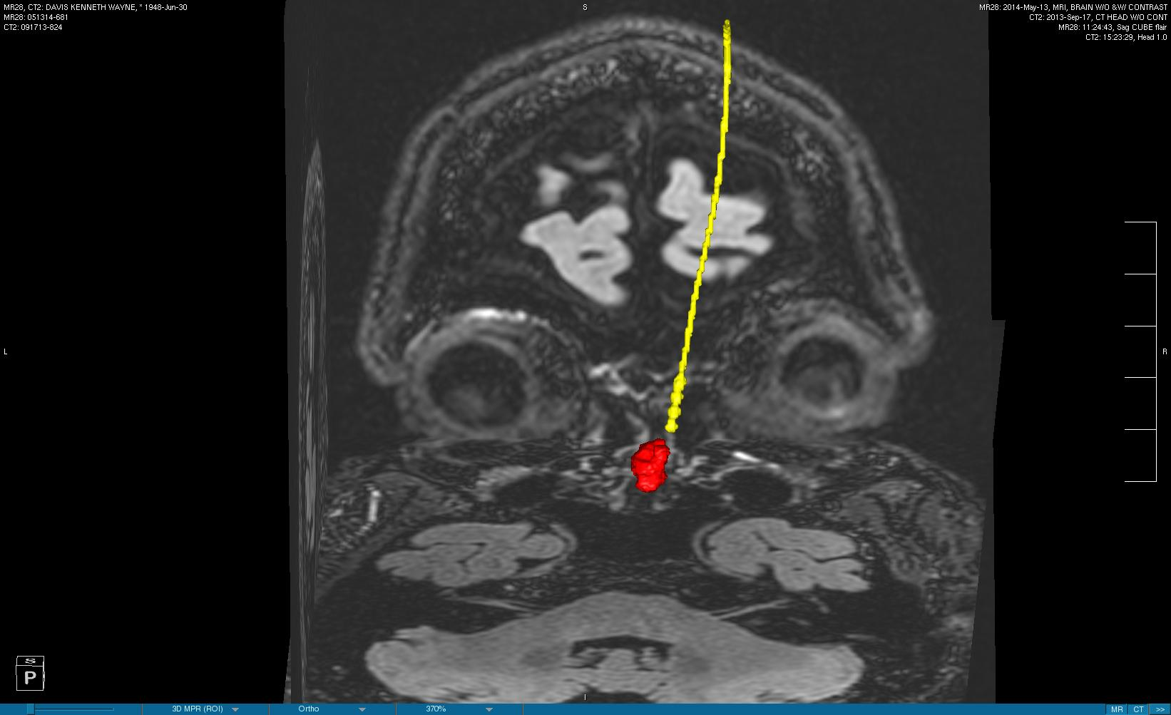
Case Presentation
Segmentation – old DBS was removed and new more medial DBS lead implanted:

Slide 33
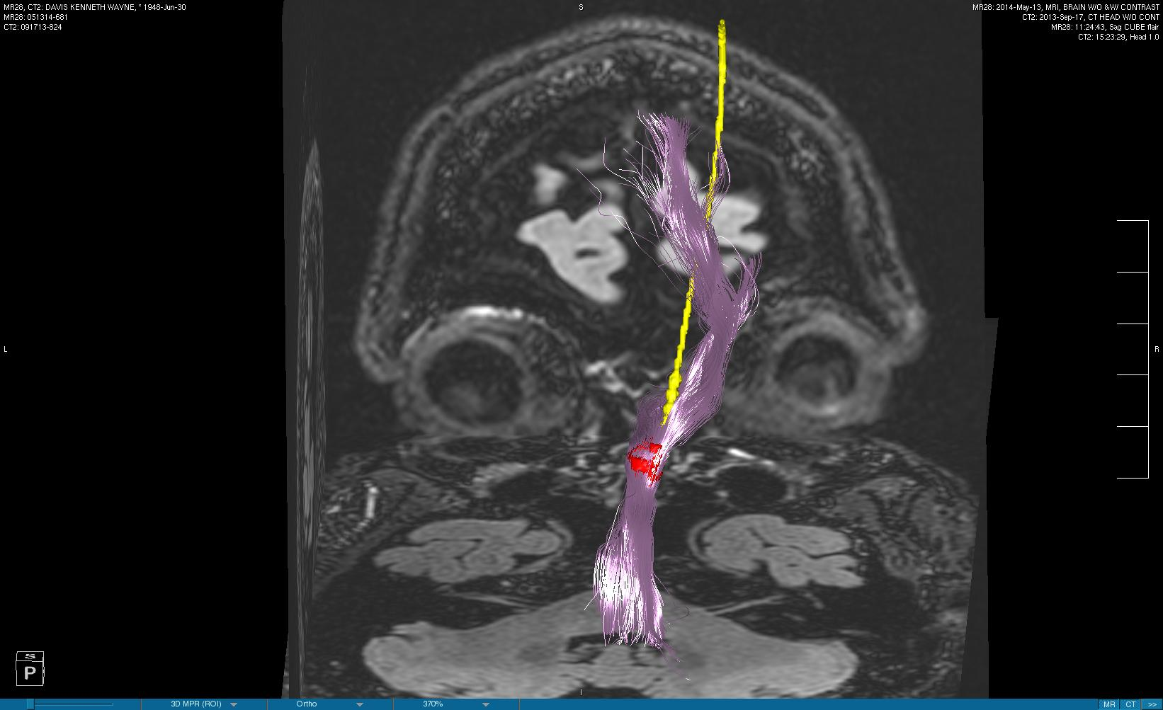
Case Presentation
Tractography – new DBS bottom contacts in dentato-rubro-thalamic tract:

Slide 34
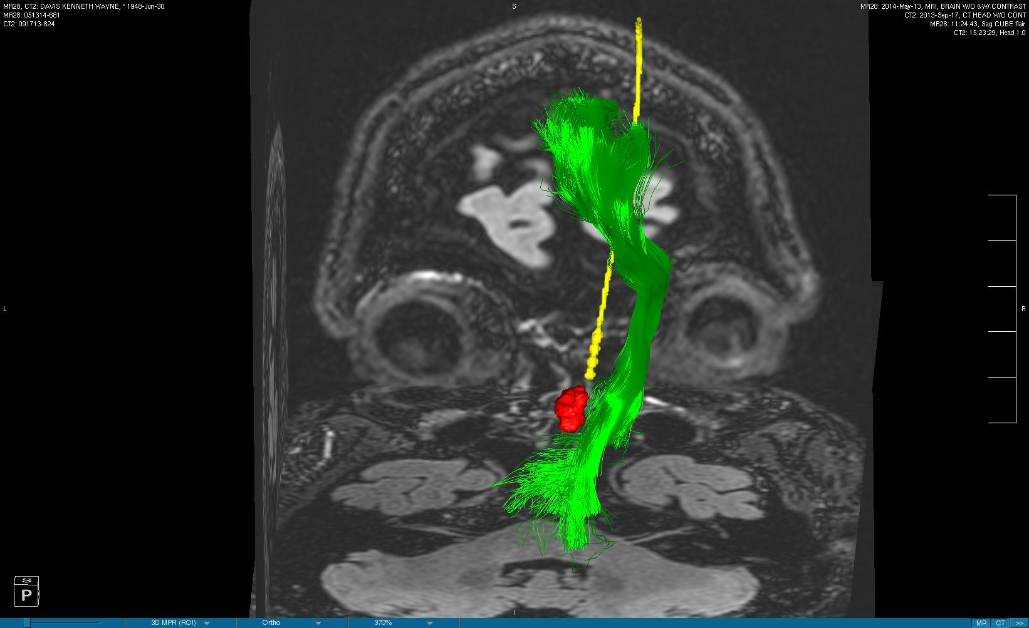
Case Presentation
Tractography – new DBS contacts now far from corticospinal tract:

Slide 35
Case Presentation
Merged old and new postoperative CTs – comparison of old DBS and new DBS positions:
Patient now has good tremor control and no side effects!

Slide 36
DTI of Heart

Slide 37
Additional resource

